Slide 1

Data Structures and Algorithms Final Project
Anuj Gupta (122561)

Slide 2
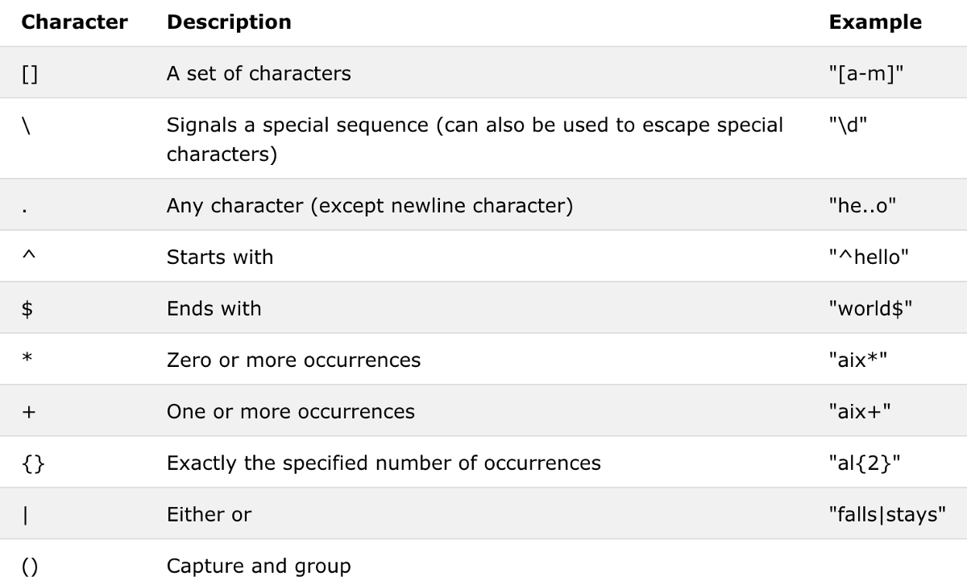
Brief Introduction to REGEX
Built in Python library that allows for pattern matching on strings of any size
Specific patterns used in this project:
. [dot] matches anything and everything (except \n)
| [vertical pipe] matches the patterns before and after it
* [asterisk] matches zero or more occurrences of the pattern before it
( ) [parentheses] groups patterns together
(?<=) [positive lookbehind] only extracts text following it
(?=) [positive lookahead] only extracts text preceding it
Special characters used in regex patterns (Wang, C.)

Slide 3


Brief Introduction to BEAUTIFUL SOUP
A specialized python library for extracting text from markup languages
Commonly used with a parser such as lxml for lighting fast lookup and data conversion
Other necessary libraries:
Python requests - numpy, pandas - Selenium (optional; for automating browser activity)
soup = BeautifulSoup(html_text, “html_parser”)
driver = webdriver.Chrome()
entries = soup.find_all(“tag”, “class_”)

